Slide 1
The Future of Clinical Bioinformatics:
Overcoming Obstacles to Information Integration
Barry Smith
Brussells, Eurorec Ontology Workshop, 25 November 2004

Slide 2
IFOMIS
Institute for Formal Ontology and Medical Information Science (Saarbrücken)
ontology-based integation / quality control in biomedical terminologies
SNOMED-CT, FMA, NCI Thesaurus ...
Gene Ontology, SwissProt/UniProt, MGED ...

Slide 3
The challenge of integrating genetic and clinical data
Two obstacles:
The associative methodology
The granularity gulf
role of existing and future ontologies in overcoming these obstacles

Slide 4
First obstacle: the associative methodology
Ontologies are about word meanings
(‘concepts’, ‘conceptualizations’)

Slide 5
‘Concept’ runs together:
meaning shared in common by synonymous terms
idea shared in common in the minds of those who use these terms
universal, type, feature or property shared in common by entities in the world

Slide 6
There are more word meanings than there are types of entities in reality
unicorn
devil
canceled workshop
prevented pregnancy
imagined mammal
fractured lip ...

Slide 7
A is_a B =def.
‘A’ is more specific in meaning than ‘B’
meningitis is_a disease of the nervous system
unicorn is_a one-horned mammal

Slide 8
Biomedical ontology integration
will never be achieved through integration of meanings or concepts
the problem is precisely that different user communities use different concepts

Slide 9
The linguistic reading of ‘concept’
yields a smudgy view of reality, built out of relations like:
‘synonymous_with’
‘associated_to’

Slide 10
Fruit
SimilarTo
Vegetable
NarrowerThan
Orange
Apfelsine
SynonymWith
Goble & Shadbolt

Slide 11
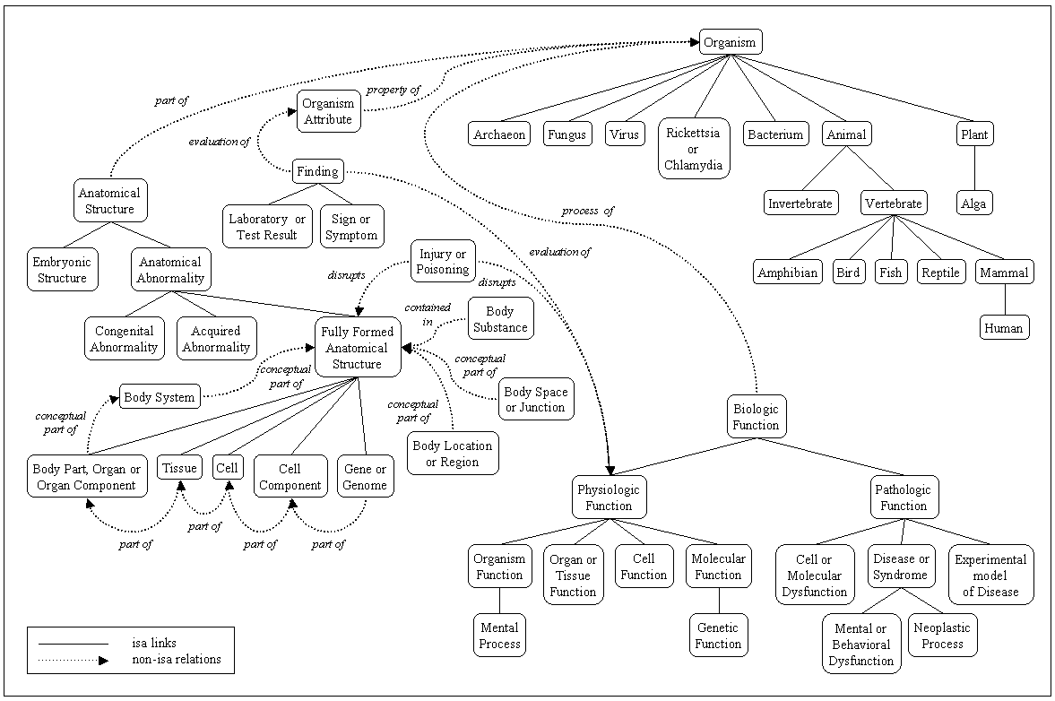
UMLS Semantic Network

Slide 12
UMLS Semantic Network
anatomical abnormality associated_with daily or recreational activity
educational activity associated with pathologic function
bacterium causes experimental model of disease

Slide 13
The concept approach can’t cope at all with relations like
part_of = def. composes, with one or more other physical units, some larger whole
contains =def. is the receptacle for fluids or other substances

Slide 14
connected_to =def.
Directly attached to another physical unit as tendons are connected to muscles.
How can a meaning or concept be directly attached to another physical unit as tendons are connected to muscles ?

Slide 15
Idea: move from associative relations between meanings to strictly defined relations between the entities themselves

Slide 16
supplement associative (statistical) datamining with: better data better annotations (link to EHR) better integration more powerful logical reasoning

Slide 17


Digital Anatomist
Foundational Model of Anatomy
(Department of Biological Structure, University of Washington, Seattle)
The
first crack
in the wall

Slide 18
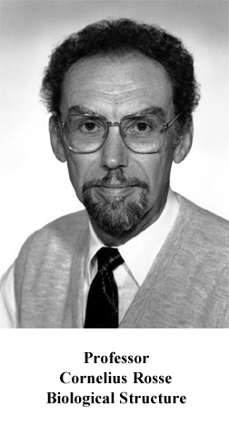

Slide 19
Anatomical Space
Anatomical
Structure
is_a
Organ Cavity
Subdivision
Organ
Cavity
Organ
Organ Part
Serous Sac
Cavity
Subdivision
Serous Sac
Cavity
Serous Sac
Organ
Component
Organ
Subdivision
Tissue
Pleural Sac
Pleura(Wall
of Sac)
Pleural
Cavity
part_of
Parietal
Pleura
Visceral
Pleura
Interlobar
recess
Mediastinal
Pleura
Mesothelium
of Pleura

Slide 20
Pleural Sac
Pleura(Wall
of Sac)
Pleural
Cavity
Parietal
Pleura
Visceral
Pleura
part_of
Interlobar
recess
Mediastinal
Pleura
Mesothelium
of Pleura
Tissue
Reference Ontology
for Anatomy at every
level of granularity
Cell
Organelle

Slide 21
The Gene Ontology
Second crack
in the wall
European Bioinformatics Institute, ...
Open source
Transgranular
Cross-Species
Components, Processes, Functions

Slide 22
But:
No logical structure
Viciously circular definitions
Poor rules for coding, definitions, treatment of relations, classifications
so highly error-prone

Slide 23
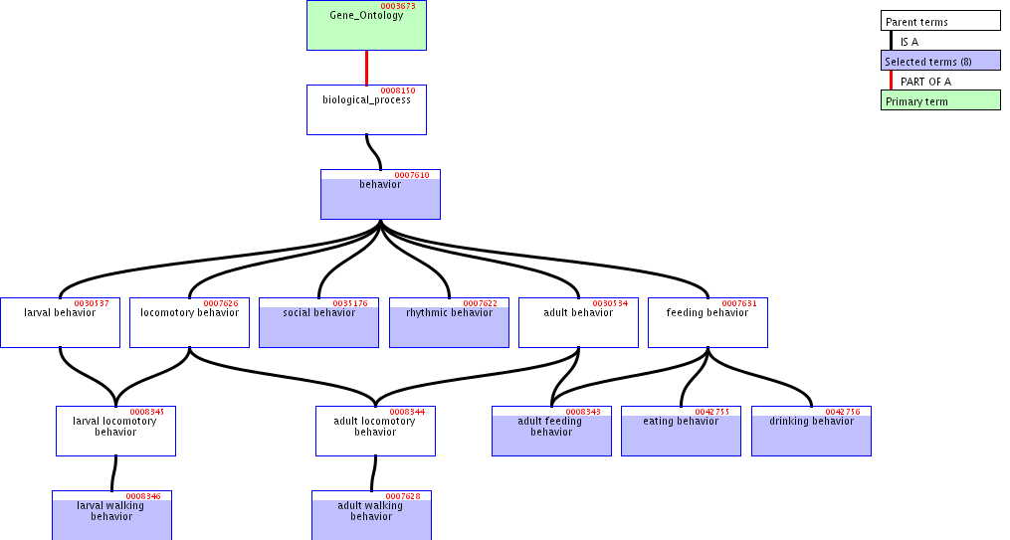

Slide 25
cars
red cars Cadillacs cars with radios

Slide 26
New GO / OBO Reform Effort
OBO = Open Biological Ontologies

Slide 27
OBO Library
Gene Ontology
MGED Ontology
Cell Ontology
Disease Ontology
Sequence Ontology
Fungal Ontology
Plant Ontology
Mouse Anatomy Ontology
Mouse Development Ontology
...

Slide 28
coupled with
Relations Ontology (IFOMIS)
suite of relations for biomedical ontology to be submitted to CEN as basis for standardization of biomedical ontologies
+ alignment of FMA and GALEN

Slide 29
Key idea
To define ontological relations like
part_of, develops_from
not enough to look just at universals / types:
we need also to take account of instances and time
(= link to Electronic Health Record)

Slide 30
Kinds of relations
<universal, universal>: is_a, part_of, ...
<instance, universal>: this explosion instance_of the universal explosion
<instance, instance>: Mary’s heart part_of Mary

Slide 31
part_of
for universals
A part_of B =def.
given any instance a of A
there is some instance b of B
such that
a instance-level part_of b

Slide 32
derives_from
(ovum, sperm → zygote ... )
C
c at t
C₁
c₁ at t₁
time
C'
c' at t
instances

Slide 33
transformation_of
same instance
C
c at t
C₁
c at t₁
time
pre-RNA → mature RNA
child → adult

Slide 34
transformation_of
C₂ transformation_of C₁ =def. any instance of C₂ was at some earlier time an instance of C₁

Slide 35
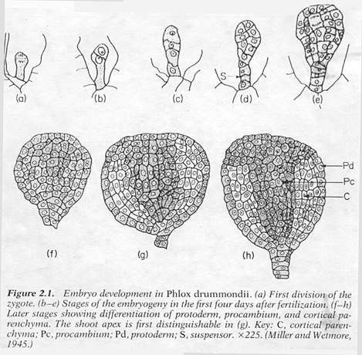
C
c at t
C₁
c at t₁
embryological development

Slide 36
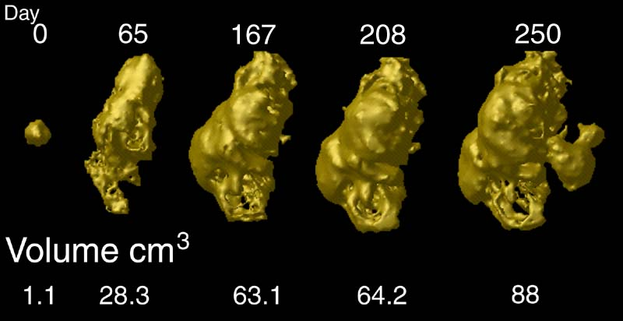
tumor development
C
c at t
C₁
c at t₁
Notes:
http://www.loni.ucla.edu/~thompson/HBM2000/tumor_volumes.jpg

Slide 37
The Granularity Gulf
most existing data-sources are of fixed, single granularity
many (all?) clinical phenomena cross granularities

Slide 38
Universe/Periodic Table
clinical space
molecule space

Slide 39
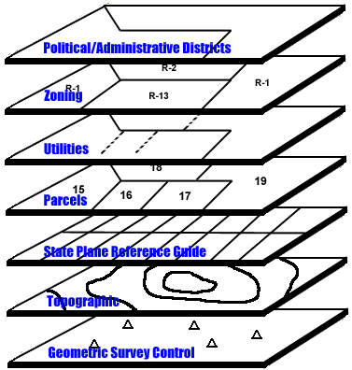
intragranular arcs
contained_in
adjacent_to
has_participant
part_of
contained_in

Slide 40
transgranular arcs
part_of

Slide 41
transformation_of
C
c at t
C₁
c at t₁

Slide 42
time & granularity
c at t₁
C₁
transformation
C
c at t

Slide 43
cancer staging
c at t₁
C₁
transformation
C
c at t

Slide 44
Standardized formal ontology yields:
better data (more reliable coding)
link to EHR via time and instances
better integration of ontologies
more powerful tools for logical reasoning

Slide 45
and help us to integrate information
on the different levels of molecule, cell, organ, person, population
and so create synergy between medical informatics and bioinformatics at all levels of granularity

Slide 46
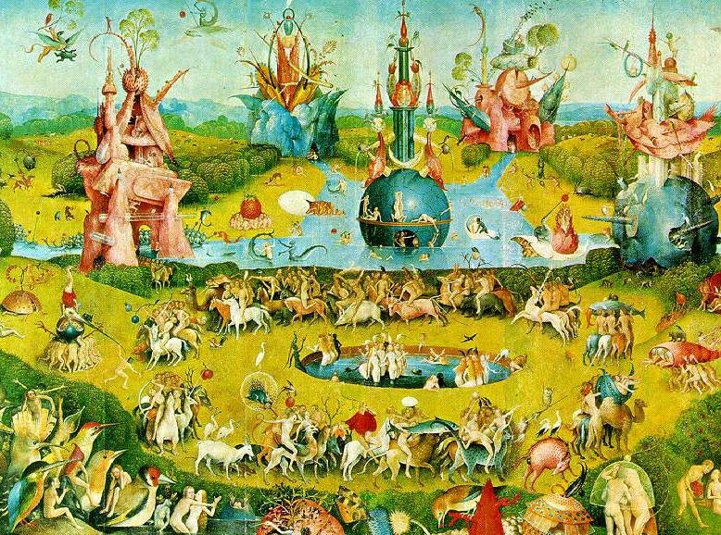
E N D E

